Slide 1

PREDICTING PEDIATRIC APPENDICITIS
Using AWS Cloud Based Machine Learning
DATS 6450 Cloud Computing - Group3
December 1, 2025
Presented By: Abirham Getie, Haeyeon Jeong, Yonathan Shimelis

Slide 2

Group 3
Quick
Agenda
01
02
03
04
Project Summary
AWS Architecture + Team Roles
Demo Workflow
Results & Takeaways

Slide 3
Group 3
Project Summary
Build an end-to-end AWS ML pipeline to predict pediatric appendicitis.
Goal
S3: Shared central storage for datasets, model results, and visuals.
EC2 with Shared AMI (Jupyter): Common environment for preprocessing and model training
IAM Policies: Enable cross-account read/write to S3 for all team members.
Main AWS Services
Pipeline
Data Load → Preprocess → Model → Evaluate → Visualize
Dataset: Regensburg Pediatric Appendicitis (UCI ID 938)
- 782 rows | 53 features | Target = Diagnosis (Appendicitis / No)
- Variables: WBC, CRP, Appendix Diameter, Ultrasound findings
Data Source

Slide 4
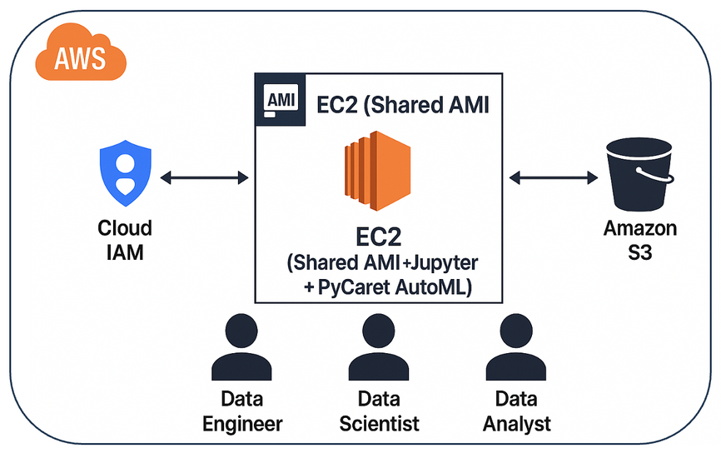
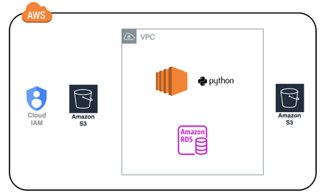
Group 3
AWS Architecture + Team Roles
Services Used
Role Summary
Improved
Original
Role | Main Tasks
Data Engineer | Creates shared AMI Sets IAM policy Uploads raw dataset to S3
Data Scientist | Read the data from S3 and preprocesses data Trains ML models and saves results to S3
Data Analyst | Reads model results from S3 Visualizes performance Uploads visuals back to S3
Used: S3, EC2 (Shared AMI + Jupyter +PyCaret AutoML),
IAM Policy
Removed: RDS

Slide 5

Group 3
Demo Workflow
01
Data
Engineer
Check 3 bucket structure + Policy
Launch EC2 instance from the shared AMI
Open Jupyter Notebook and run the code
Confirm collected dataset uploaded to S3

Slide 6

Group 3
Demo Workflow
02
Data
Scientist
Use Jupyter Notebook to load data from S3
Train and evaluate ML models on EC2
Used AutoML to identify best performing model
Save model results to S3

Slide 7
Group 3
Demo Workflow
03
Data
Analyst
Access model results csv from S3
Create performance charts and comparison plots
Upload visuals to S3

Slide 8
Results & Takeaways
Folders in our S3 bucket include:
data/ → cleaned datasets
models/ → stored models
results/ → model performance CSV
visuals/ → plots and charts
Outcomes:
Fully shared AWS workflow across 3 accounts
End-to-end automation of data cleaning and upload
Collaboration through S3 instead of local files
Outputs
Key features for model prediction include appendix diameter, white blood cell count, and C-reactive protein measurements
Used AutoML to evaluate a broad range of classification models and the search identified HistogramGradientBoostingClassifier as the best-performing model with a CV F1 Macro of 0.95
Modeling takeaways
Demonstrated how S3 and EC2 enable team-based machine learning.
Achieved secure, reproducible workflow without extra services like RDS.
Future step: deploy model for real-time prediction using AWS Lambda.
Conclusion

Slide 9

Thank You
Group 3: Abirham Getie, Haeyeon Jeong, Yonathan Shimelis

